Slide 1
Digital Portfolio
STUDENT NAME: Kanmani M
REGISTER NO AND NMID: asunm1112401111033016
DEPARTMENT: BCA
COLLEGE: L. N. Government College, Ponneri/Madras University

Slide 2

PROJECT TITLE
Machine Learning: Unlocking The Power of Data

Slide 3
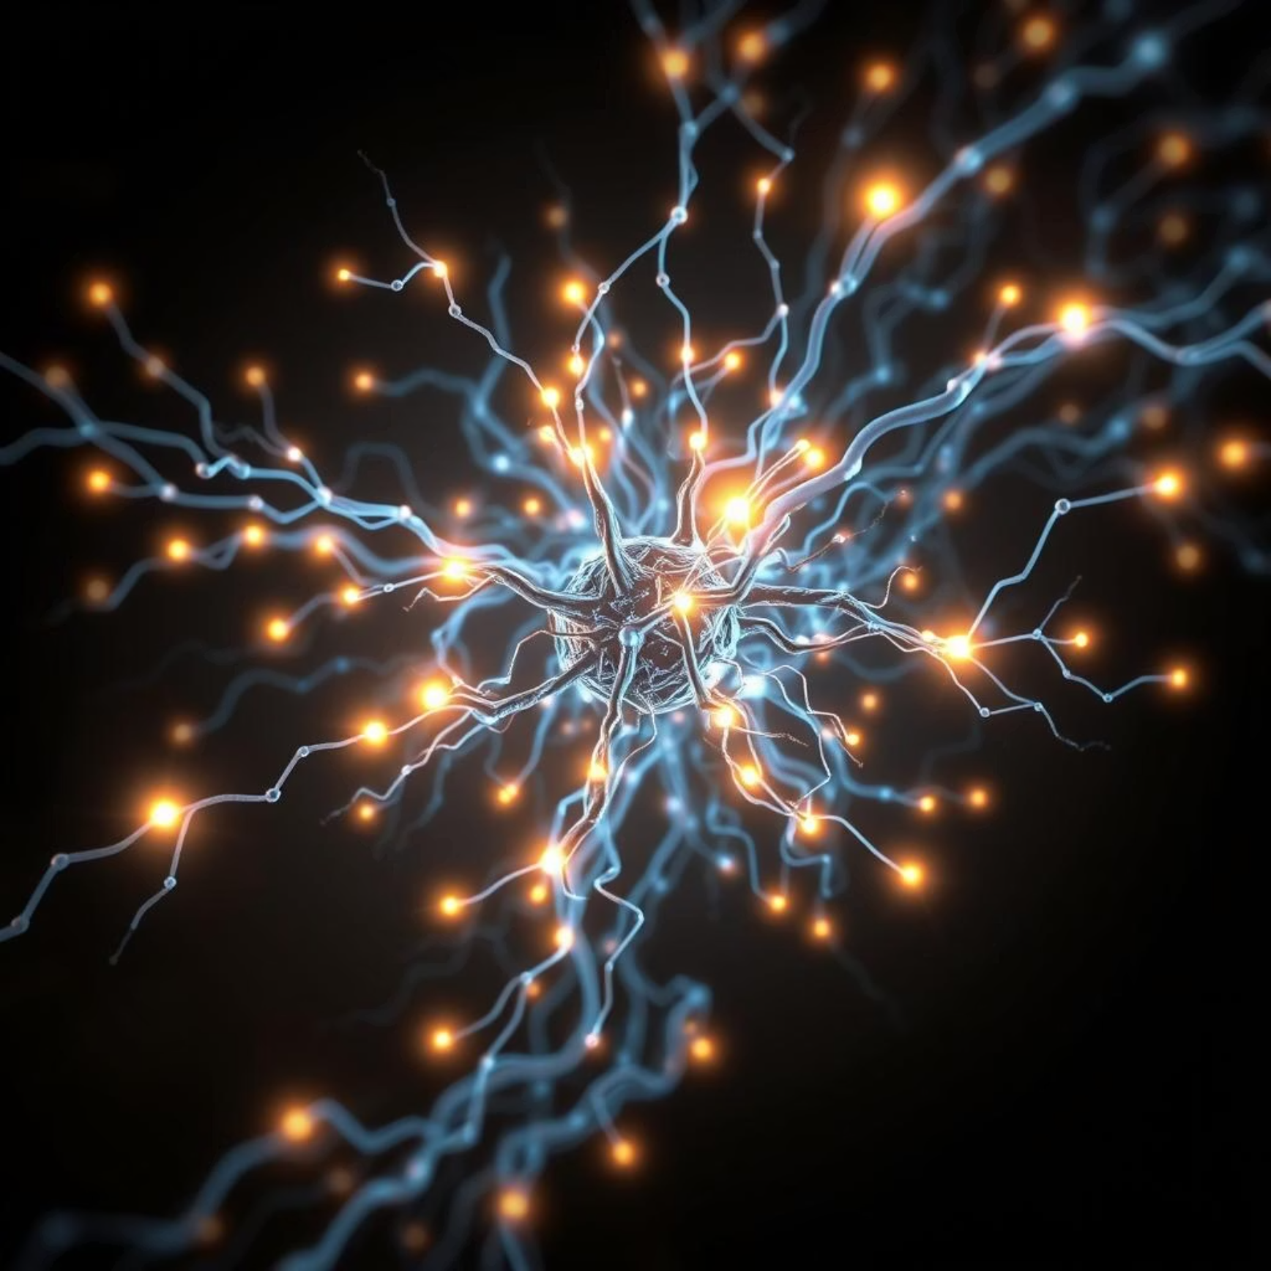
AGENDA
Problem Statement
Project Overview
End Users
Tools and Technologies
Portfolio design and Layout
Features and Functionality
Results and Screenshots
Github link
Conclusion

Slide 4
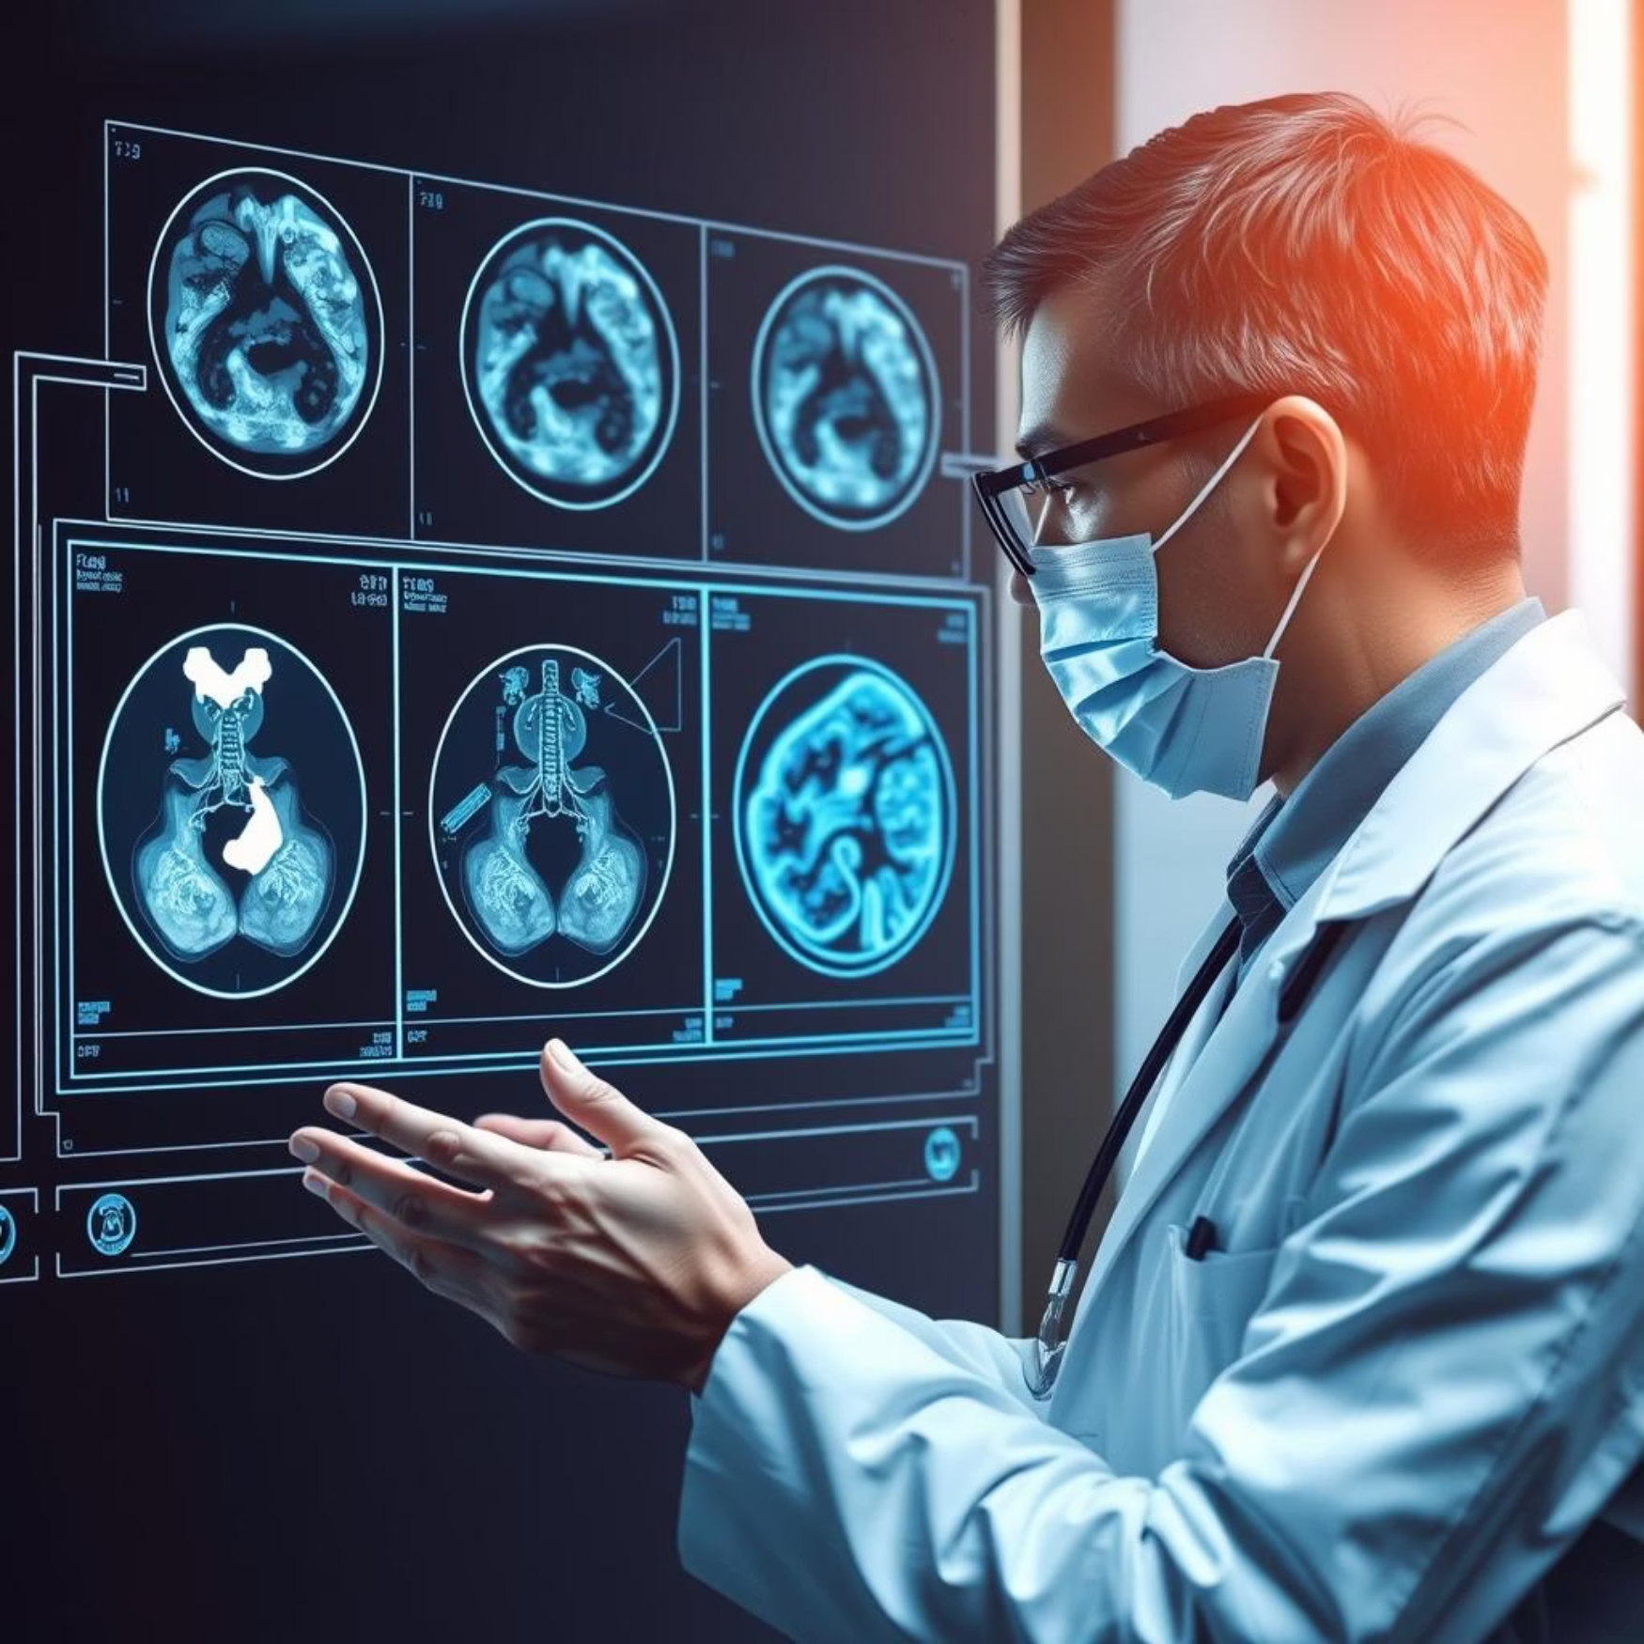
PROBLEM STATEMENT
Despite rapid technological growth, India continues to face critical challenges in agriculture, healthcare, and urban management due to limited access to timely information and efficient systems. Farmers struggle with unpredictable weather, crop diseases, and low productivity; rural populations face delayed or unaffordable healthcare; and urban cities suffer from traffic congestion, accidents, and pollution. Traditional systems are inefficient, leading to economic losses, poor health outcomes, fuel wastage, and reduced quality of life.

Slide 5
PROJECT OVERVIEW
This project leverages Machine Learning to address critical challenges in agriculture, healthcare, and urban management. In agriculture, ML enables crop health monitoring, weather forecasting, and smart recommendations for irrigation and fertilizers, empowering farmers with data-driven decisions. The goal is to increase productivity, reduce losses, and promote sustainable farming practices. In healthcare, ML helps bridge rural healthcare gaps through disease detection, AI chatbots for primary consultations in local languages, and predictive outbreak tracking. These solutions ensure affordable, accessible, and preventive healthcare for millions of people. In urban management, ML is applied to intelligent traffic systems, using computer vision to detect congestion and accidents. Reinforcement learning optimizes traffic signals, while predictive analytics improve public transport efficiency. The overall outcome is reduced losses in agriculture, better healthcare delivery, smarter cities, less pollution, and an improved quality of life.

Slide 6
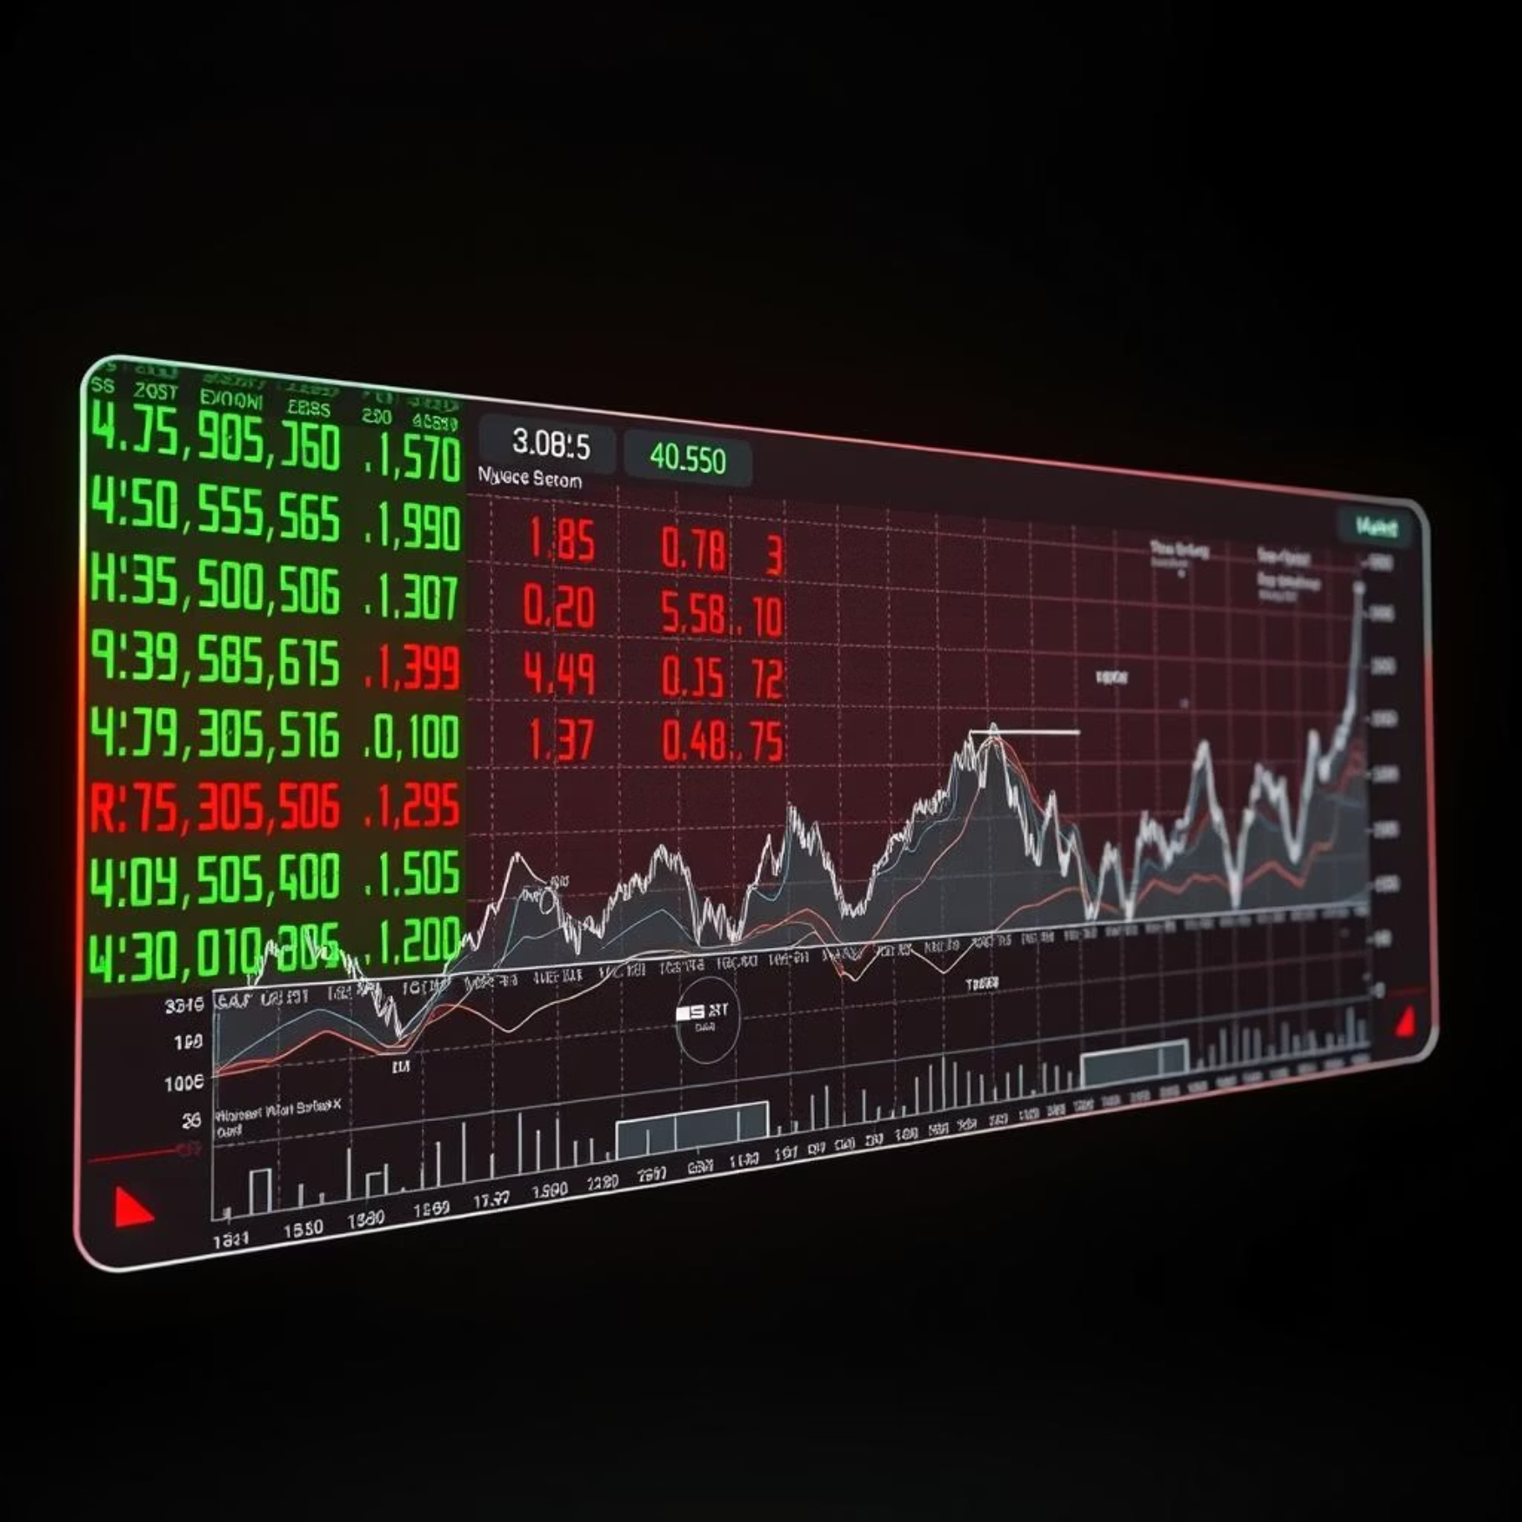
WHO ARE THE END USERS?
Farmers – use AI tools for crop monitoring, weather forecasting, and better yield. Agricultural cooperatives – analyze large-scale farming data for planning. Government agencies – support policy-making, subsidies, and rural development. Agri-tech start-ups – develop innovative, data-driven solutions for agriculture. Patients in rural & semi-urban areas – gain faster, affordable diagnosis and treatment. Doctors and healthcare workers – make accurate decisions with AI-powered tools. Public health organizations – track and manage disease outbreaks effectively. Government healthcare schemes – ensure wider healthcare accessibility. Daily commuters – benefit from reduced traffic congestion and safer travel. Traffic police – monitor, detect, and respond quickly to incidents. Public transport authorities – plan efficient routes with predictive analytics. City planners & Smart City projects – design sustainable urban infrastructure.

Slide 7
TOOLS AND TECHNIQUES
Programming Language: Python as the primary language for ML development. Machine Learning Libraries: Scikit-learn, TensorFlow, PyTorch for building and training models. Computer Vision Tools: OpenCV for crop monitoring, traffic analysis, and disease detection. Natural Language Processing (NLP): For chatbots, medical report analysis, and smart assistants. Development Platforms: Jupyter Notebook / Google Colab for experimentation and coding. Big Data Handling: Pandas, NumPy for data preprocessing and large-scale dataset management. Visualization Libraries: Matplotlib, Seaborn, Plotly for data insights and reporting. Cloud Platforms: AWS, Google Cloud, Azure for scalable storage, model deployment, and APIs. Version Control: GitHub for collaboration and project management. Integration Tools: APIs for connecting ML models with mobile and web applications. Together, these tools help build smart, scalable, and impactful real-world ML solutions.

Slide 8
POTFOLIO DESIGN AND LAYOUT
The design uses a modern and simple interface with clear navigation. The Home section introduces the student with name, tagline, and key focus: “Machine Learning: Unlocking the Power of Data”. The About Me section highlights passion for ML, career goals, and interest in building intelligent data-driven solutions. The Projects section showcases 3 major ML applications: 1. Customer Churn Prediction – identifying customers likely to leave a service. 2. Sentiment Analysis on Social Media – understanding opinions and feedback.
3. Predictive Healthcare (Disease Prediction) – supporting faster and accurate medical insights. Each project card includes a title, short description, and clear layout for easy understanding. The Contact section provides a simple way for direct communication. The portfolio is responsive, working smoothly on mobile, tablet, and desktop. The layout balances professionalism and creativity, leaving a strong impression.
8

Slide 9
FEATURES AND FUNCTIONALITY
Showcases Real-World ML Projects Displays three end-to-end machine learning projects: Customer Churn Prediction Sentiment Analysis on Social Media Predictive Healthcare (Disease Prediction). Clean and Simple User Interface: Easy-to-navigate design highlighting projects and achievements. Problem Statements & Solutions: Clearly defines the real-world problems tackled and the ML-driven solutions provided. Technical Tools & Techniques: Highlights tools like Python, Scikit-learn, TensorFlow, NLP techniques, and deployment frameworks. Responsive Design: Works seamlessly on laptops, tablets, and mobile devices. About Me Section: Introduces the portfolio owner with career goals, passion for ML, and academic journey. Contact & Collaboration Option: Allows easy communication for networking, internships, or project collaborations. Professional Branding: Builds credibility by showcasing hands-on ML expertise and deployment-ready projects. Portfolio Value: Serves as a strong academic and career portfolio for placements, higher studies, or research opportunities.

Slide 10
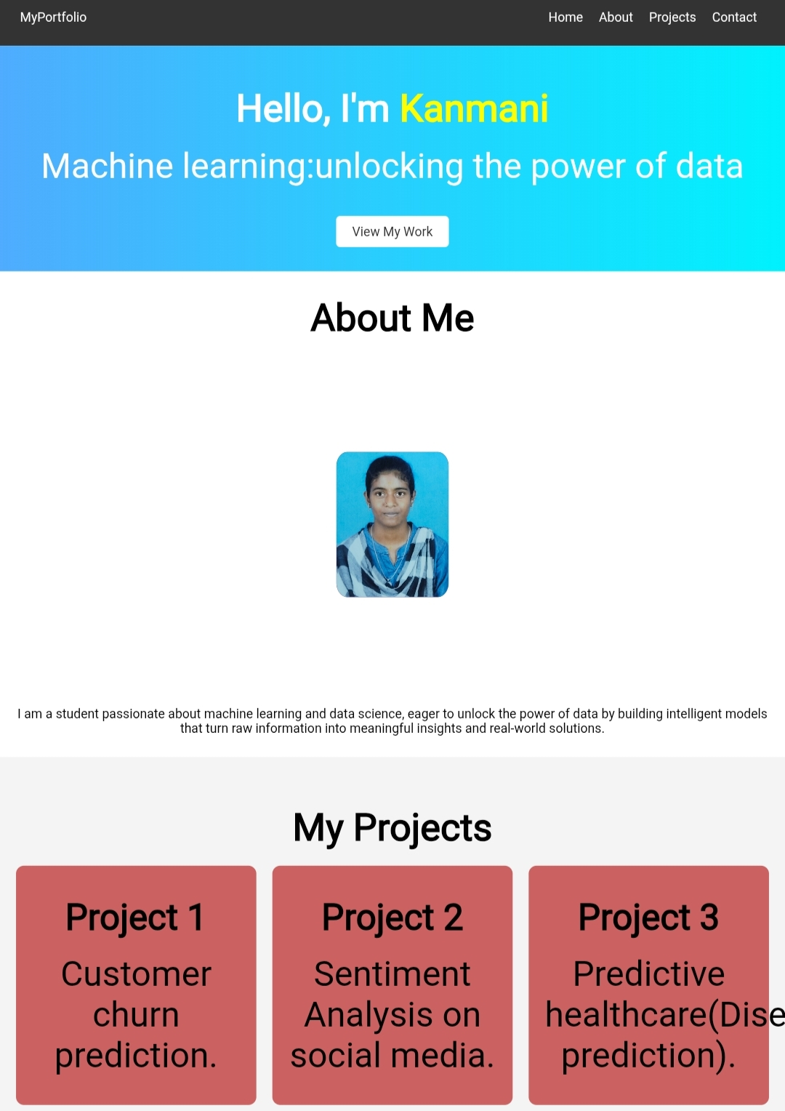
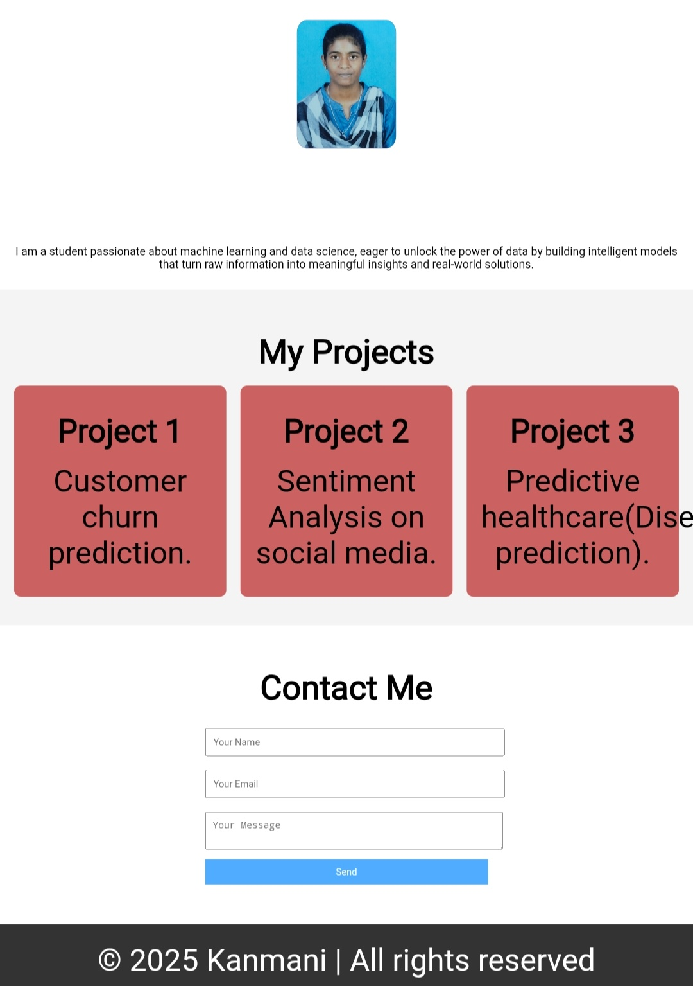
RESULTS AND SCREENSHOTS
10

Slide 11
Github link
https://kanmani-debug.github.io/Myprofile/
https://kanmani-debug.github.io/Myprofile/

Slide 12

CONCLUSION
Machine Learning is unlocking the power of data and driving innovation. The projects in this portfolio demonstrate practical knowledge of AI, ML, Data Science, and real-world applications. Customer Churn Prediction helps businesses retain valuable customers through data-driven insights. Sentiment Analysis on Social Media enables organizations to understand public opinion and improve engagement. Predictive Healthcare (Disease Prediction) supports early diagnosis and promotes affordable, accessible medical care. The portfolio highlights technical expertise, creativity, and problem-solving abilities. It is valuable for students, researchers, startups, and industry professionals exploring ML solutions. These projects enhance career opportunities and contribute to the advancement of digital innovation. In conclusion, Machine Learning projects showcased in this portfolio act as a gateway to smarter businesses, healthier lives, and a data-driven future.
12

Slide 13
●◉✿◦•●◉✿Thank you✿◉●•◦✿◉●

